Slide 1
Let’s Write an Emulator!
A (very) Basic Crash Course in Writing an Emulator using the CHIP-8 Language/VM.
Scott Faria
scott.faria@protonmail.com
https://github.com/sfaria

Slide 2
What is an emulator?
An emulator is a software program (or hardware platform!) that enables a computer system, the host, to behave like another type of computer system (from here on out we will call it the guest).
For our purposes, an emulator is software that runs foreign code and responds to its low-level commands in a way that the guest system would expect to.
Game Boy on MacOS? Commodore 64 running on your Windows 10 Machine?
… Doom on a toaster?

Slide 3
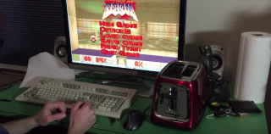
THE FUTURE IS NOW

Slide 4
Why write an emulator?
It’s fun!
You learn a lot about the guest system and how it works at a low level.
Preservation of computing history.
Keep those old programs running.
Some day these old computers and gaming consoles will no longer work.
Emulation keeps them alive.

Slide 5
What is CHIP-8?
CHIP-8 is a simple language/interpreter written in 1977 for 8-bit microcomputers such as the RCA TELMAC-1800 and COSMAC VIP.
These computers were very simple hobbyist devices.
1.76 MHz RCA 1802 CPU
2 KB RAM (Expandable to 4 KB! LUXURIOUS!)
Compact Cassette storage
Hex (16 key) keyboard
Monochrome Video
Single Beeper-style speaker

Slide 6
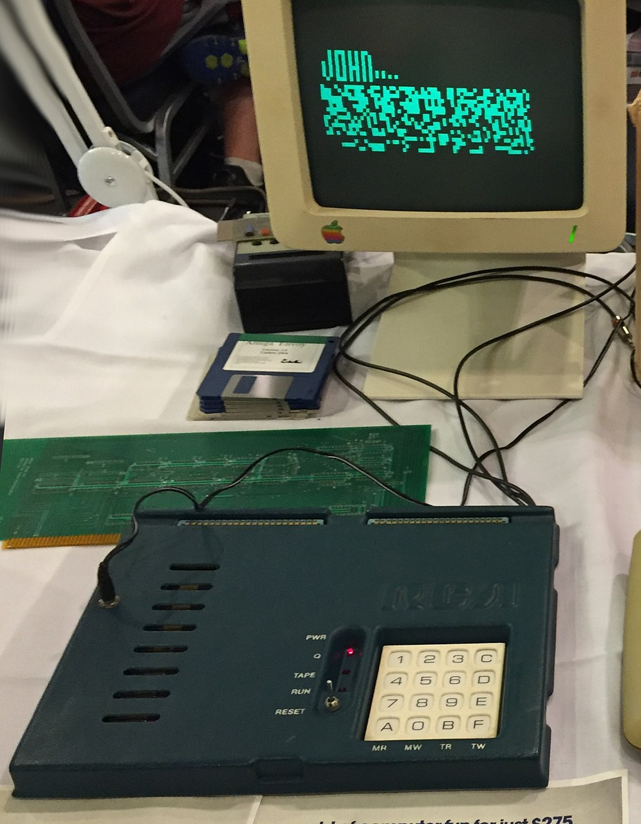
COSMAC VIP

Slide 7
CHIP-8 History
The CHIP-8 language was revived in the early 1990s by a guy named Andreas Gustafsson.
He wrote a CHIP-8 interpreter for the HP48 graphing calculator in order to more easily write games and programs for the platform.
His adaptation later spawned more emulators and even extensions to the CHIP-8 “architecture” to add extra features that didn’t exist on the original.
CHIP-48
Super CHIP-48

Slide 8
Why CHIP-8?
First and foremost: It’s simple. Compared to even other 8-bit systems CHIP-8 is dead simple by design.
It was designed to enable quick and easy programming that could adapt to different hardware.
There is plenty of documentation available and quite a lot of sample code to learn from.

Slide 9
CHIP-8 Architecture (CPU)
4KB RAM
512 bytes are reserved for the interpreter (i.e. not usable by programs)
16 general purpose 8-bit registers.
V0-VF
16-bit instruction register.
Two 8-bit registers called delay and sound that handle timing and sound, respectively.
A stack of sixteen 16-bit values to represent the call stack for subroutines.
16-bit program counter and stack counter “registers”.

Slide 10
CHIP-8 Architecture (I/O)
Sound is a single tone beeper.
Video is a 64x32 pixel, monochrome display.
Keyboard is a 16 key hexadecimal pad.

Slide 11
Simple!?
As an example, the CPU in the Atari 2600 (8-bit MOS 6507) has:
56 instructions.
Up to 64KB of memory access
Variable length stack.
Each instruction has to be fully implemented.
More instructions === More complication.

Slide 12
But, like, how!?
In order to build an emulator that behaves like the system the program expects, we act like it.
We follow the same formula all classical computers use:
Fetch
Decode
Execute
Remember that from your CS classes?

Slide 13
Don’t Halt and Probably Don’t Catch Fire
Fetch
We need to get an instruction from memory, which will contain either an instruction or data.
Decode
Once we read that memory, we need to figure out what the program wants to do with it.
Execute
Given our newly decoded instruction we do what it wants, updating the right registers, memory, counters, etc.

Slide 14
Let’s Play Fetch
If we want to fetch something there needs to be something to fetch, right?
The first step we take in CHIP-8 emulation is reading the ROM into memory.
We read the ROM file bytes and we copy a single byte at a time into memory starting at memory location 512.
Remember, our memory is organized in 4096 byte wide “words”.
We set the Program Counter to 512.

Slide 15

Let’s Play Fetch
We have filled our memory, so now we have to fetch our first instruction.
(WARNING: BIT MATH INCOMING/!\)
Each instruction in CHIP-8 is 16 bits (2 bytes) wide.
We read 2 sequential bytes from memory:
Now we combine them into a single 2 byte value:

Slide 16
Let’s Play Fetch
What?
Let’s break that down a bit.

Slide 17
Let’s Play Fetch
One instruction is 16 bits wide. We have two 8-bit values. Let’s glue em’ together!
We take our “high byte” (memory[ProgramCounter]) and we cast it to a short:
1000_0011 (0x83) -> 1111_1111_1000_0011
(note: Why the leading 1’s?)
Then we take that number and left shift (<<) it by 8 to move it to the higher 8 bits:
1111_1111_1000_0011 -> 1000_0011_0000_0000

Slide 18
Let’s Play Fetch
We now take our “low byte” (memory[ProgramCounter++]) and we upcast that as well:
0100_0010 (0x42) -> 0000_0000_0100_0010
(note: Why the 0’s this time?)
Then we AND the low byte value with 0x00FF (again, why?) and then we OR the high byte and low byte together:
1000_0011_0100_0010 (0x8342)
We have our instruction! 0x8342

Slide 19
Sync the Decoder Rings
What do we do with 0x8342?
We look it up and see what that means!
All CHIP-8 instructions like this have a format that tell you it’s function and its variables.
The highest “nibble” (half-byte!), 8, tells us this is an arithmetic function. Looking that up we can now know what to do with the rest of the nibbles:
Now that we know the instruction “family”, we can see that the 0x8xxx functions all follow the formula of:
First nibble (MSN): family (8)
Second nibble: variable X value (3)
Third nibble: variable Y value (4)
Fourth nibble (LSN): Specific instruction (2)
For 0x8342 that means: 8XY2 - Set VX to VX AND VY

Slide 20
Execute Order 66
Now what?
Fill those registers!
We take the value of register v3, bitwise AND that with the value of register v4 and store that back in v3.
We’ve performed our first instruction! We did math, pat yourself on the back!

Slide 21
Execute Order 66
There are many such opcodes for CHIP-8.
They handle arithmetic, drawing to the screen, sound, etc.
Each pass of the decode phase you increment the program counter, take the opcode, find the correct operation and fill in the registers to match.

Slide 22
Going with the Flow
The rest of the program’s flow is just repeating this same 3 step process.
Loop back around, fetch a new opcode, find the operation and execute it.
The program will either loop back on itself (programs do that, ya know) or we hit the end of memory space.

Slide 23
Well, what about sound?
Remember those two timers, delay and sound?
Well, when sound > 0, a single tone is played.
That timer counts down by 1 at a steady 60hz. That means the bigger the number, the longer the sound will play.
Clever, huh?
The setting of the timers controlled by two opcodes:
0xFx18 - LD ST, Vx
0xFx07 - LD Vx, DT

Slide 24
And Video?
CHIP-8 video is a 64x32 canvas that allows sprites that are 8 bits wide by n bits tall to be drawn to the screen.
Rasterized drawing (ex. drawing pixel by pixel) is not allowed.
The operation is Dxyn - DRW Vx, Vy, n

Slide 25
And Video?
We point to the memory location in our instruction register. This is our first sprite line.
We take those 8 bits and write them starting at our (vX, vY) on screen.
If a bit is turned off, we have a collision has happened and a flag is set.
We increment y and then repeat until y == n.

Slide 26
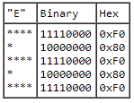
And Video?
Each row in the binary column is an 8-bit line of the sprite.
Each line is written from MSB to LSB in the X direction.
Once the line is written, we increment Y and repeat.
Once we reach the height n we stop drawing.

Slide 27
Live Demo
Check out the code and program at:
https://github.com/sfaria/CHIP-8-Emulator
Completely written in Java with zero 3rd party dependencies. ROMs are plentiful and all over google!

Slide 28
References
http://www.pong-story.com/chip8/
http://devernay.free.fr/hacks/chip8/
https://en.wikipedia.org/wiki/CHIP-8

